Slide 1
PM 工作流程
PM工作流程匯總
PM’s work process
Notes:
1

Slide 2
EVT/ DVT/ PVT
Pilot Run

Slide 3
EVT&DVT&PVT定义 Definition
EVT: Engineering Verification Test 的简称，意为 工程验证测试，产品开发初期的设计验证。设计者对设计出来的样品做初期的测试验证，包括一般功能测试和安规测试，一般由RD对样品各项功能进行全面验证，因是样品，问题可能较多，测试可能会做几次。
At this stage, a number of product samples are prepared and subjected to the most critical tests from the relevant standards and other requirements set out in the Design Brief. Producing and testing a number of samples at this stage helps give RD more information about product performance, the manufacturing processes and steps likely to be required. Test data is reviewed to ensure that the required performance is achieved. Successful completion of the EVT stage enables RD to release the product to manufacture in agreement with the customer.

Slide 4
EVT&DVT&PVT定义 Definition
DVT: Design Verification Test的简称， 意为设计验证测试，是硬件生产中不可缺少的一个检测环节，包括模具测试、电子性能、外观测试等等。解决样品在EVT阶段的问题后进行，对所有信号的电平和时序进行测试，完成安规测试，此时产品基本定型。
DVT focuses on perfecting tools and techniques for a consistent run and ensures products meet cosmetic and environmental requirements using both mass production tools and parts. With a build of 50-200, units are put through rigorous tests such as burning, dropping from certain heights, submerging in water as well as extensive battery testing. This step is also crucial for products needing regulatory certifications such as FCC or UL. This is the final step before making units that are suitable for sale. At the end of DVT, you should be highly confident that any issues causing unacceptable yields have been corrected.

Slide 5
EVT&DVT&PVT定义 Definition
PVT:Process Verification Test的简称，意为小批量过程验证测试，验证新机型的各功能实现状况并进行稳定性及可靠性测试，此产品为出货完成品
PVT (production validation testing) is the first official production run, often 5-10% of the first run, where teams verify that the product can be made at the volumes needed for the target cost. Ideally, these units will be suitable to sell and will become part of volume ramp. It’s important to note that in PVT, your QA (quality assurance) and QC (quality control) procedures are developed which will allow the CM to check for any failures throughout the manufacturing process. As products come off the line, it’s the last opportunity for adjustments to tools to be made. Once performance and quality have been verified and signed off, it’s onto mass production!

Slide 6
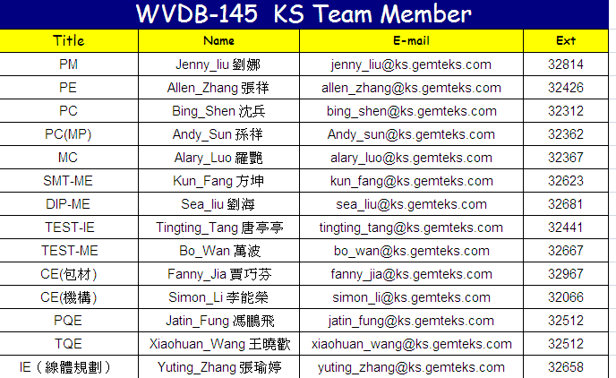
1. Build up team list
（一）DVT/PVT試產流程 Process
1.TW PM提出試產需求,開案,根據信息建立Team List（例如）
1. Build up team list

Slide 7
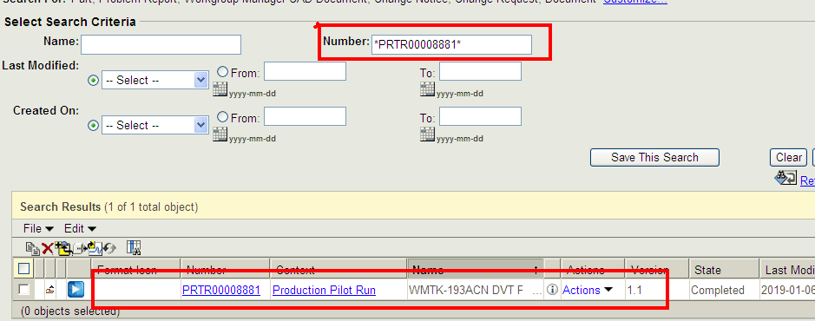
2. Received the P/R application
2.TW PM 開立DVT試產單 (例:PRTR00008881),KS PM收試產單之後根據單號在PLM系統中查詢相關信息（PVT試產單依同樣的方式查詢）
2. After received the P/R application, check related info in PLM

Slide 8
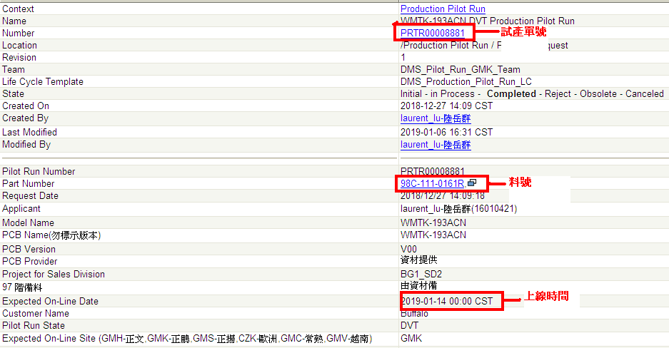
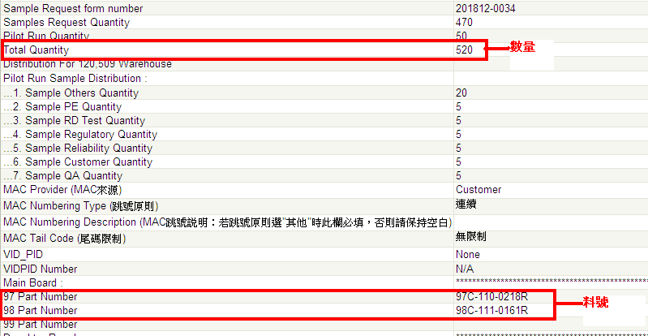
2-1 Example
*DVT試產PRTR00008881相關查詢資料如下：
*For example: Number/ Part number/ on line date/ Qty/ 97L, 98L P/N

Slide 9
3. Routing set up / 4. Material checking
3.根據試產單信息,發郵件給IE提供試產Routing,并通知PC開立試產工單
3. Routing set up, PM provide production flow Doc. number In PLM to IE--- Owner IE
And inform PC to issue WO ---- Owner PC
4. 依試產單信息,建立表格,并確認BOM是否已經OK,發郵件給物控(MC)確認料況,需要在上線日前齊料（如料未齊,需要更改上線時間）例如：
4. Material: checking what date will receive all materials---- Owner MC
*如試產工單開立后,有發DCR變更bom,需要通知MC變更工單中的用料,避免生產時與文件不符
*After received pilot run application, if there’s change in BOM, need to receive DCR and inform MC to change material in issued WO, to avoid discrepancy.

Slide 10
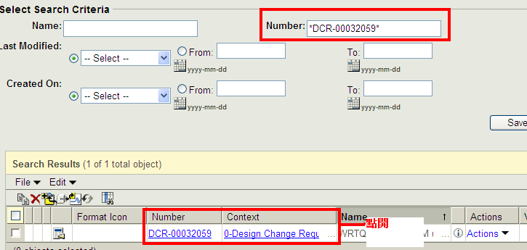
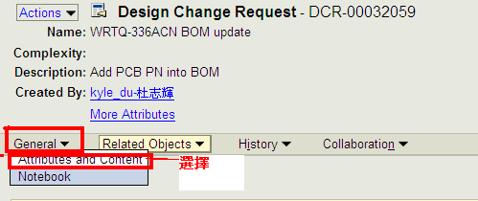
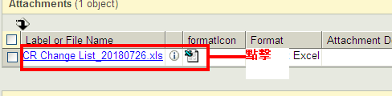
DCR- Design Change Request
* DCR查詢方式如下：(例如:DCR-00032059)
在PLM系統中輸入DCR單號,然後點開,點擊”General”,選擇”Attributes and Content”
點擊”Excel表格”,表格內容就是DCR的變更資料,
*Checking DCR in PLM (If DCR is not done IN TIME to change BOM, then there will be a Manufacturing Notice issued by TW PM)
（如試產階段DCR未簽核完成入BOM,需要發聯絡單說明）

Slide 11
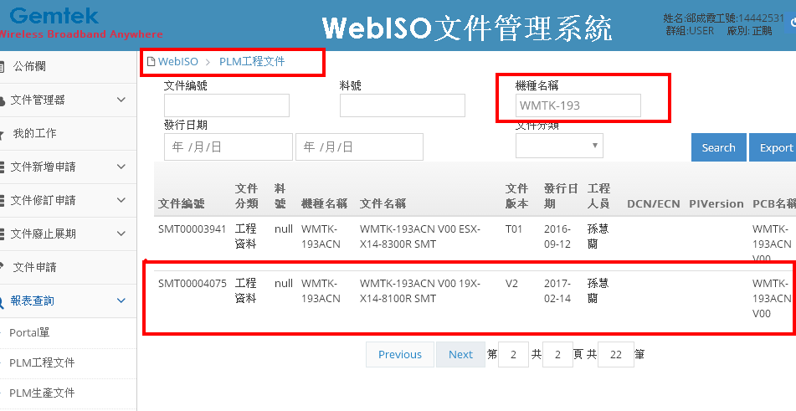
5. Preview meeting
5.召開試產 前會議,通知相關負責人員參加,討論試產生產狀況,并匯總成會議記錄,并作保存,發郵件告知會議討論結果,例如:
5. Preview meeting---Owner/ PM
*依據料號在WebISO系統中查詢Gember文件,提供單號給SMT ME,ME根據單號在PLM系統中下載文件開立鋼板,并在試產上線前完成（如沒有單號,請RD提供相關文件資料）

Slide 12
6. Set up production line
6. 通知PE架站, TW PE提供設備清單,請設備部門準備設備,并確認 在上線前完成
例如：
6. Inform PE to set up the line, normally is one week before 97L online date
------Owner PE/TE
機種移轉清單查檢表 bảng kiểm tra danh sách model chuyển sang
*生產前確認相關文件部份:（如PLM系統中未DCC,需要TW發聯絡單作業）
97階：Gerber文件+零件位置圖
98階：韌體版本通知書+機構組力圖+QC Check Item
99階：SOP（包裝）
*試產前需要與TW PM要Sample板,以便產線做治具（SMT+DIP+Test）
例如： 1 Panl PCB光板+2PCS PCBA裸板+2PCS組裝OK,功能OK的半成品
*Document and fixture/equip etc.. checking

Slide 13
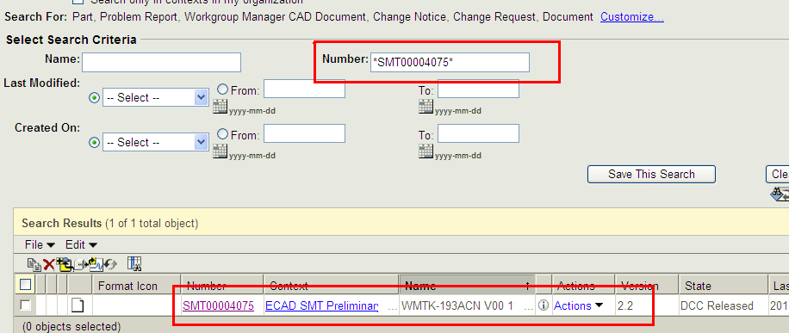
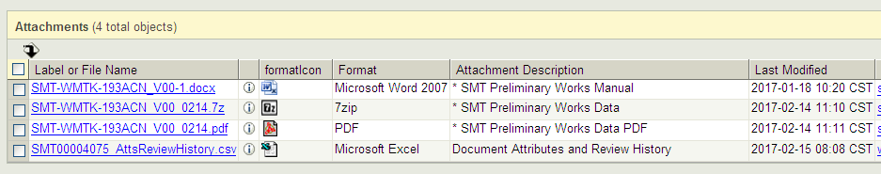
Reference
例如：97階在PLM系統中用單號查詢Gerber文件和零件位置圖

Slide 14
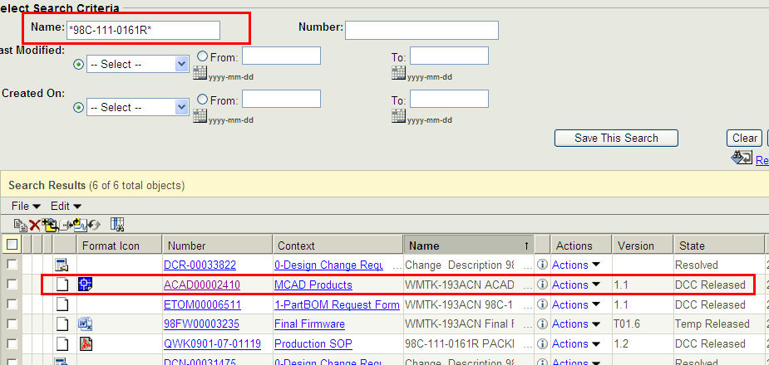
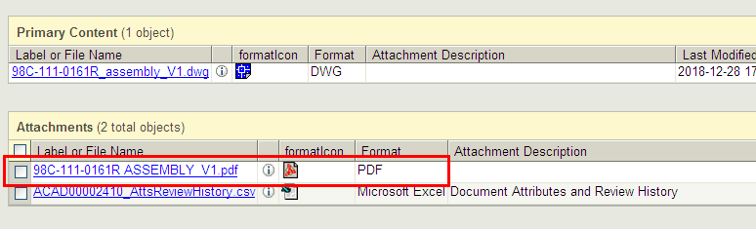
Reference
例如：98階在PLM系統中用98料號查詢韌體版本通知書+QC check Item機構組力圖
機種組力圖

Slide 15
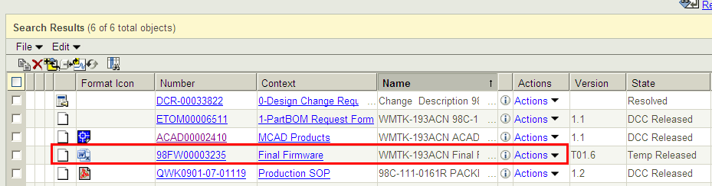
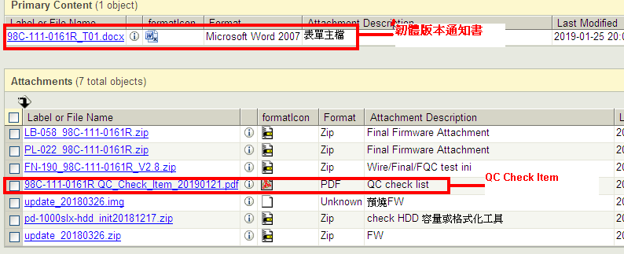
Reference
例如：韌體版本通知書+QC check Item

Slide 16
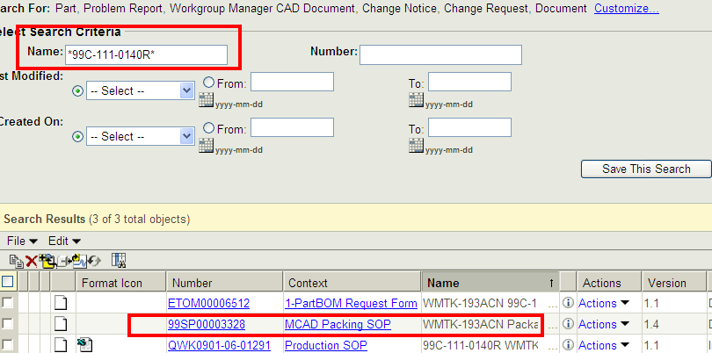
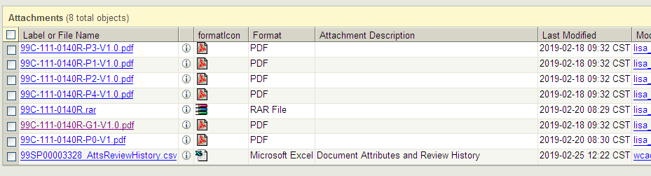
Reference
例如：99階在PLM系統中用99料號查詢SOP,點擊SOP,打開之後就是作業內容

Slide 17
7. Production 8. Tracking 9. Report 10. Review
7.發郵件給IE(線體規劃人員）,確認此機種的生產線別,以便PC安排排程
7. Inform IE to confirm which line is available, so PC can arrange production schedule
8.料況OK后,安排上線生產,追蹤試產進度,處理試產異常問題
8. Once material get ready , the pilot run can be started. And PM do the production tracking, assist to handle abnormal during production
9.試產完成后,讓PE提供試產報告,并給出試產結果Pass或者Fail
9. After pilot run, PE need to provide pilot report, define pass/fail.
10.根據試產報告,召開產后會議,并匯總成會議記錄,發郵件告知,并追蹤試產問題點的處理進度
10. Once PM has PE’s report, hold the review meeting and summarize to review meeting minutes and track the open items

Slide 18
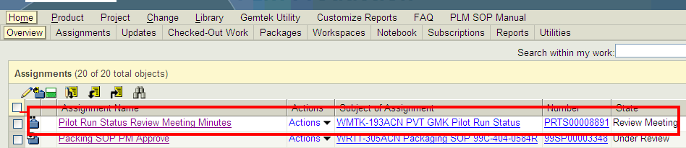
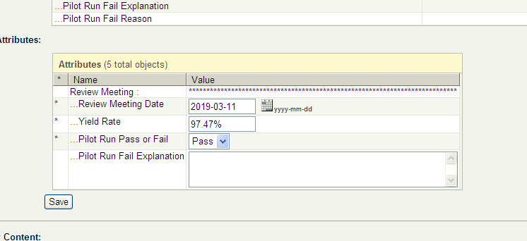
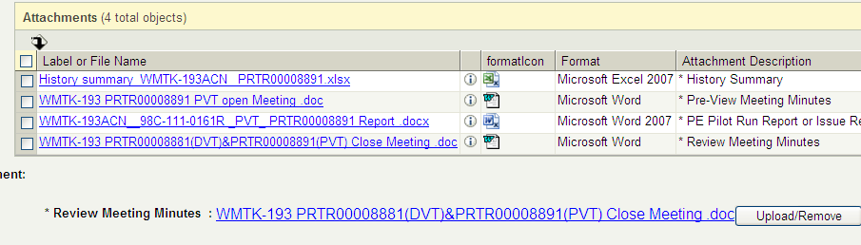
11. Upload preview/ review meeting minutes
11.試產單簽核到時,需要在PLM系統中上傳產前會議記錄和產后會議記錄（同樣的操作方式)例如：
11. Upload preview/ review meeting minutes in PLM

Slide 19
12. PVT
12. PVT試產依據DVT同樣的作業流程作業,
PVT試產單開立后,通知PC開立試產工單，MC(物控）確認料況,爭取在上線日之前齊料,安排上線,追蹤試產進度,試產完成之後,PE會將結果體現在試產報告中,召開産後會議（一般DVT&PVT試產問題點産後會議一起討論)，匯總成會議記錄(同16點）
注：PVT試產板子一般也會挪用DVT Pass 的板子作PVT包裝試產,
不一定會安排重新打件
12. PVT has the same process as DVT

